Slide 1
Using a Worksheet
Preparing a Worksheet
Multiple-column form used in preparing financial statements.
Not a permanent accounting record.
Five step process.
Use of worksheet is optional.
LO 1 Prepare a worksheet.

Slide 2
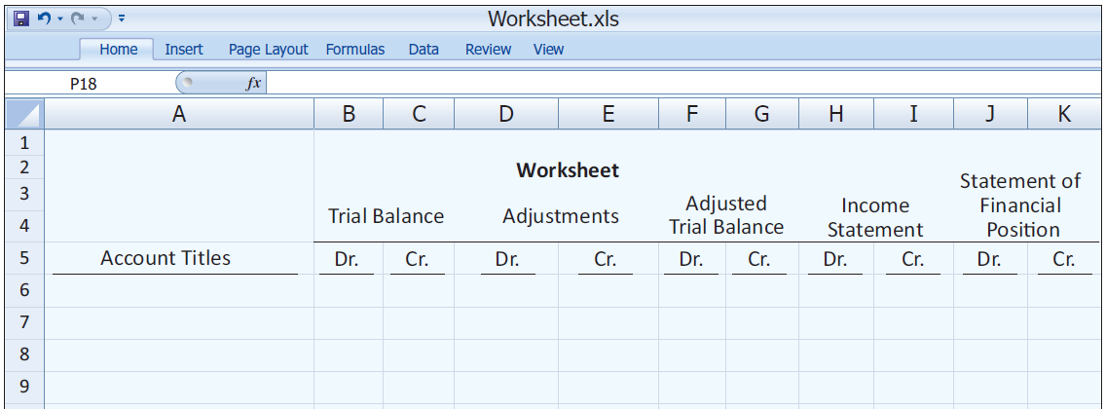
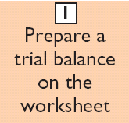
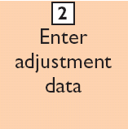
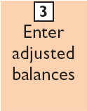
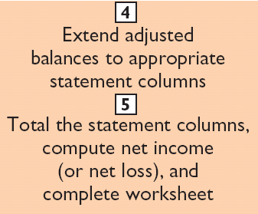
Steps in Preparing a Worksheet
Illustration 4-1
LO 1 Prepare a worksheet.

Slide 3
Steps in Preparing a Worksheet
1. Prepare a Trial Balance on the Worksheet
Illustration 4-2
Trial balance amounts come directly from ledger accounts.
Include all accounts with balances.
LO 1 Prepare a worksheet.

Slide 4
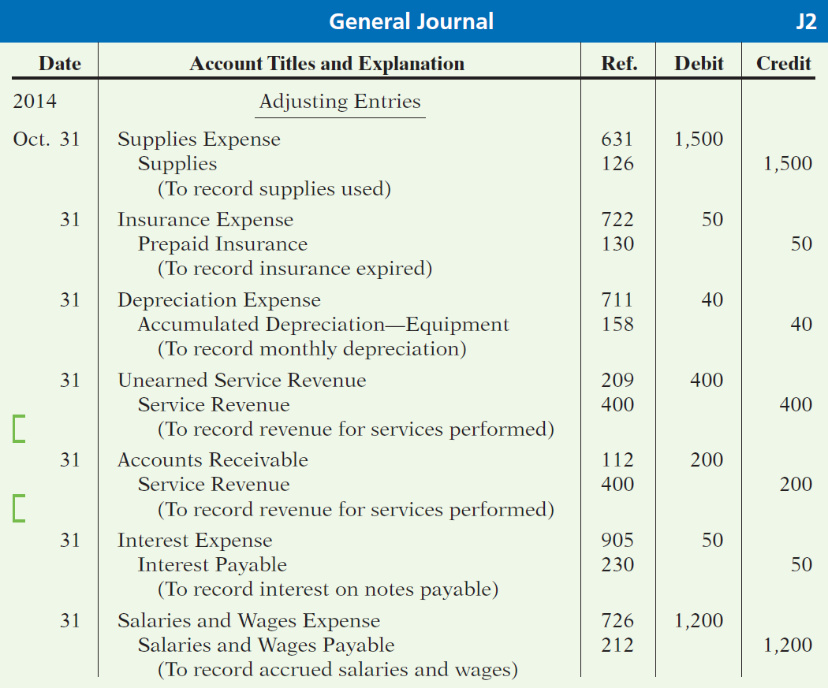
Steps in Preparing a Worksheet
Illustration 3-23
General journal showing adjusting entries
Adjusting Journal Entries
(Chapter 3)
LO 1 Prepare a worksheet.

Slide 5
Steps in Preparing a Worksheet
3. Complete the Adjusted Trial Balance Columns
(a)
(b)
(d)
(d)
(g)
(e)
(a)
(b)
(c)
(c)
(e)
(f)
(f)
(g)
Total the adjusted trial balance columns and check for equality.
LO 1 Prepare a worksheet.

Slide 6
Steps in Preparing a Worksheet
2. Enter the Adjustments in the Adjustments Columns
(a)
(b)
Adjustments Key:
(a) Supplies Used.
(b) Insurance Expired.
(c) Depreciation Expensed.
(d) Service Revenue Earned.
(e) Service Revenue Accrued.
(f) Interest Accrued.
(g) Salaries Accrued.
(d)
(d)
(g)
(e)
(a)
(b)
(c)
(c)
(e)
Enter adjustment amounts, total adjustments columns,
and check for equality.
(f)
(f)
(g)
Add additional accounts as needed.
LO 1 Prepare a worksheet.

Slide 7
Steps in Preparing a Worksheet
4. Extend Amounts to Financial Statement Columns
(a)
(b)
(d)
(d)
(g)
(e)
(a)
(b)
(c)
(c)
(e)
(f)
(f)
(g)
Extend all revenue and expense account balances to the income statement columns.
LO 1 Prepare a worksheet.

Slide 8
Steps in Preparing a Worksheet
5. Total Columns, Compute Net Income (Loss)
(a)
(b)
(d)
(d)
(g)
(e)
(a)
(b)
(c)
(c)
(e)
(f)
(f)
(g)
Compute Net Income or Net Loss.
LO 1 Prepare a worksheet.

Slide 9
Steps in Preparing a Worksheet
Review Question
Net income is shown on a worksheet in the:
income statement debit column only.
statement of financial position debit column only.
income statement credit column and statement of financial position debit column.
income statement debit column and statement of financial position credit column.
LO 1 Prepare a worksheet.

Slide 10
Using a Worksheet
Preparing Statements from a Worksheet
Income statement is prepared from the income statement columns.
Statement of financial position and retained earnings statement are prepared from the statement of financial position columns.
Companies journalize and post adjusting entries.
LO 1 Prepare a worksheet.

Slide 11
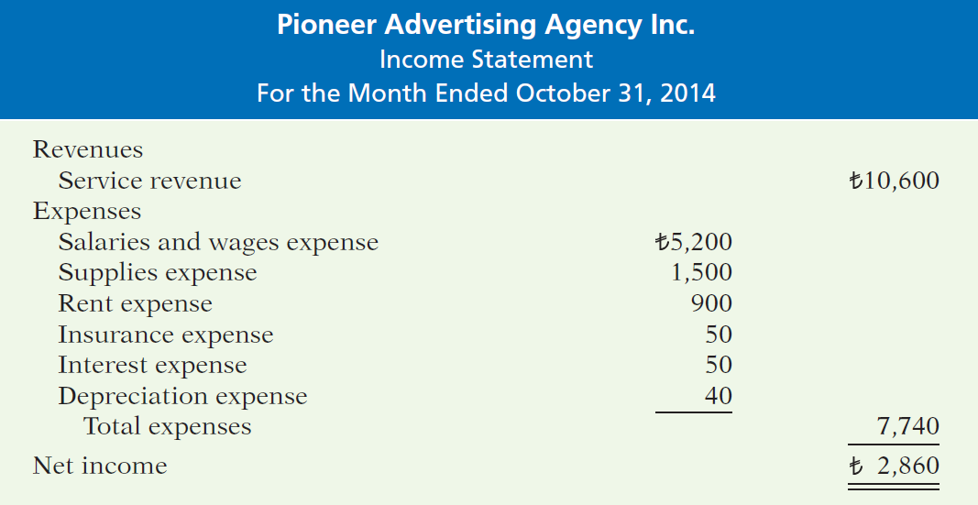
Preparing Statements from a Worksheet
Illustration 4-4
LO 1 Prepare a worksheet.

Slide 12
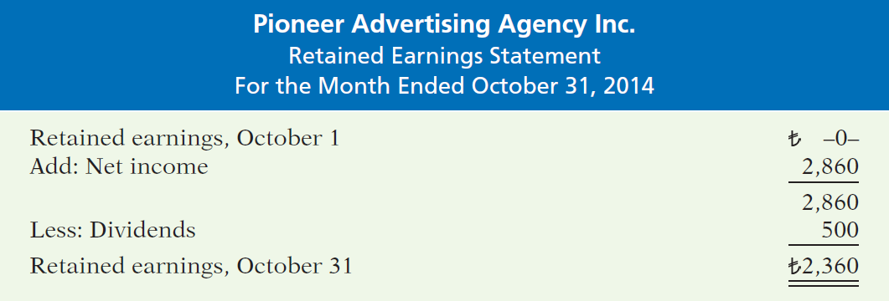
Preparing Statements from a Worksheet
Illustration 4-4
LO 1 Prepare a worksheet.

